Slide 1
Temporal and Spatial Dynamics of Land Cover and Soil Erosion
Siddeshwar Kagatikar (IMT2022026)
Hemant Gupta (IMT2022030)
Bhavya Kapadia (IMT2022095)

Slide 2
Background
The Amazon Forest, known for its rich biodiversity and critical role in regulating the global climate, has undergone significant land cover transformations and soil erosion over recent decades. Rapid land-use changes, driven by human activities and ecological restoration programs, have altered vegetation patterns and erosion dynamics. Understanding the temporal and spatial dynamics of land cover and soil erosion is crucial for assessing the effectiveness of these interventions and guiding sustainable land management in the region.
Research Paper: Spatiotemporal Variability of Soil Erosion in the Pisha Sandstone Region: Influences of Precipitation and Vegetation" by Yang et al., for soil erosion prediction

Slide 3
Problem definition and Objective
This project uses Landsat 8 imagery, CHIRPS data, and ML to predict soil erosion risks and track land cover changes over time. By analysing key indices like NDVI, slope, precipitation, and soil erodibility, we create risk maps, aiding policymakers in effective erosion management.
1. Temporal and Spatial Changes in Land Cover in the Study Area
2.Temporal and Spatial Variation of Soil Erosion in the Study Area
3. Analysis of the Effects of Vegetation and Rainfall on Soil Erosion

Slide 4
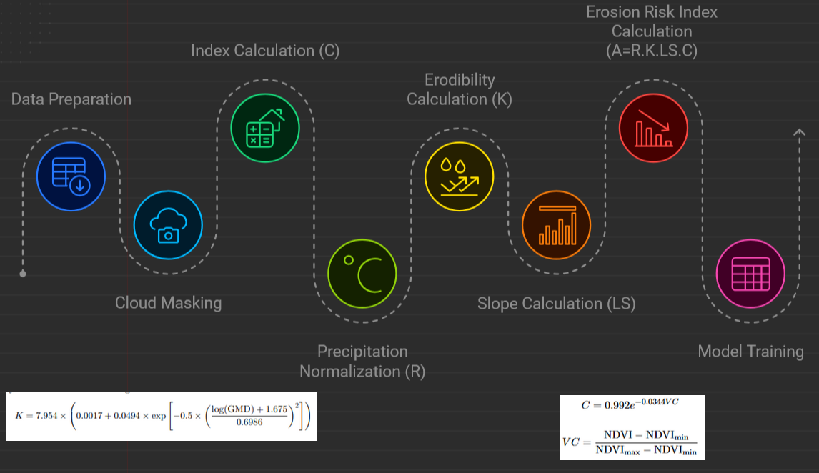

Slide 5
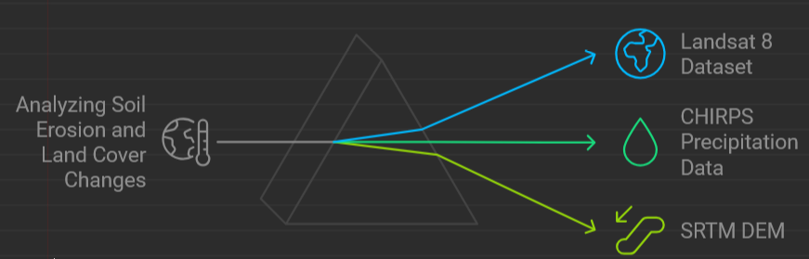
Data Used
Aim to predict soil erosion risks and monitor land cover changes. Utilizes Landsat 8 imagery, CHIRPS data, and machine learning techniques. Focus on key indices such as NDVI, slope, and precipitation.

Slide 6
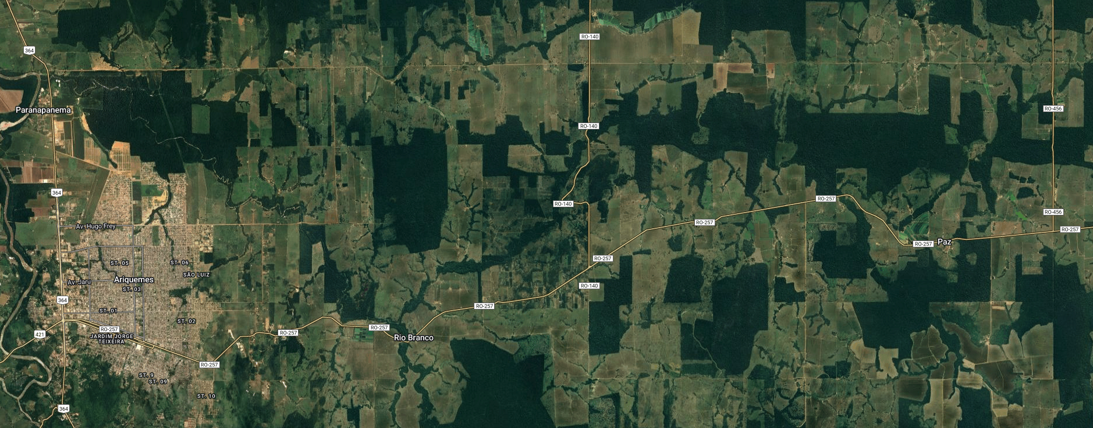
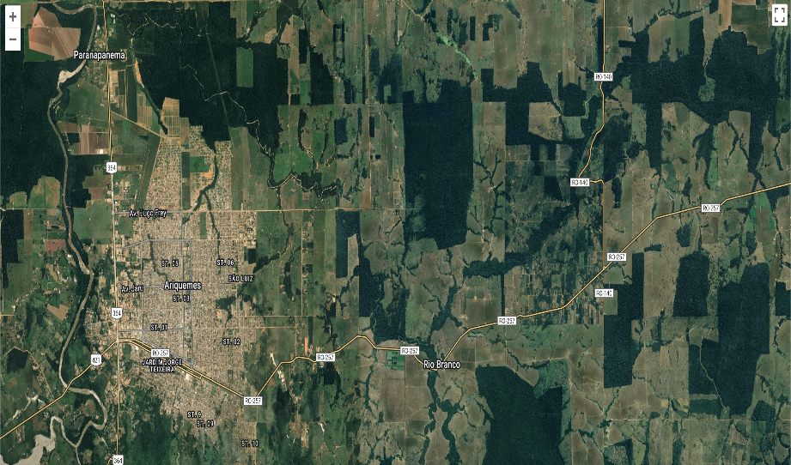
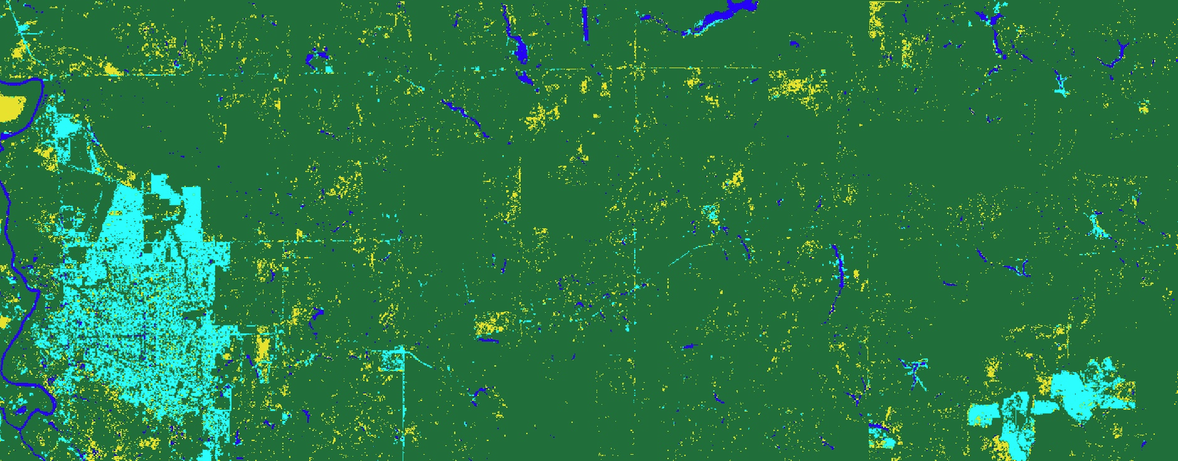
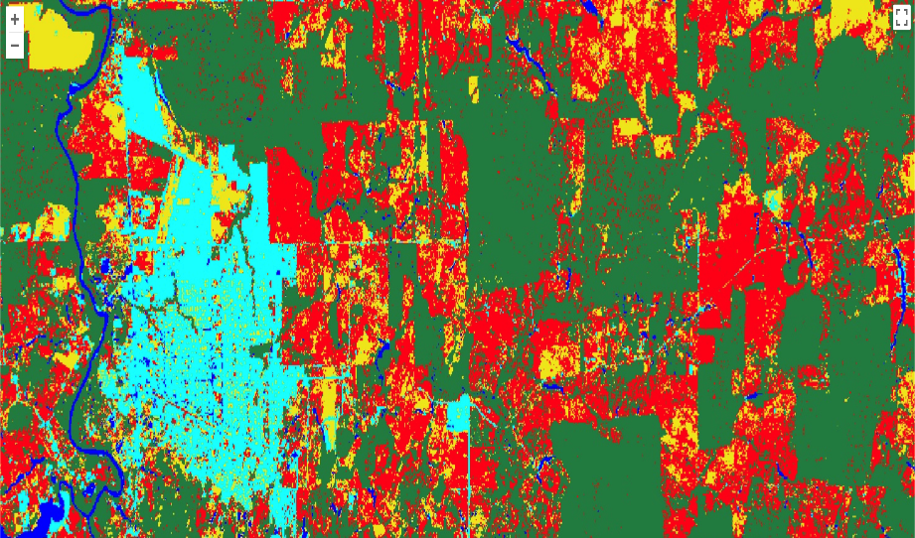
2015 Amazon Rainforest
Model – Random Forest Classifier
Accuracy – 0.9082
The first image on the left shows the original LANDSAT-8 satellite image of the Ariquemes region.
The second image displays the area classified into four categories: Built-Up Area, Densely Forested Area, Sparsely Forested Area, Deforested Area and Riverbank Area.

Slide 7
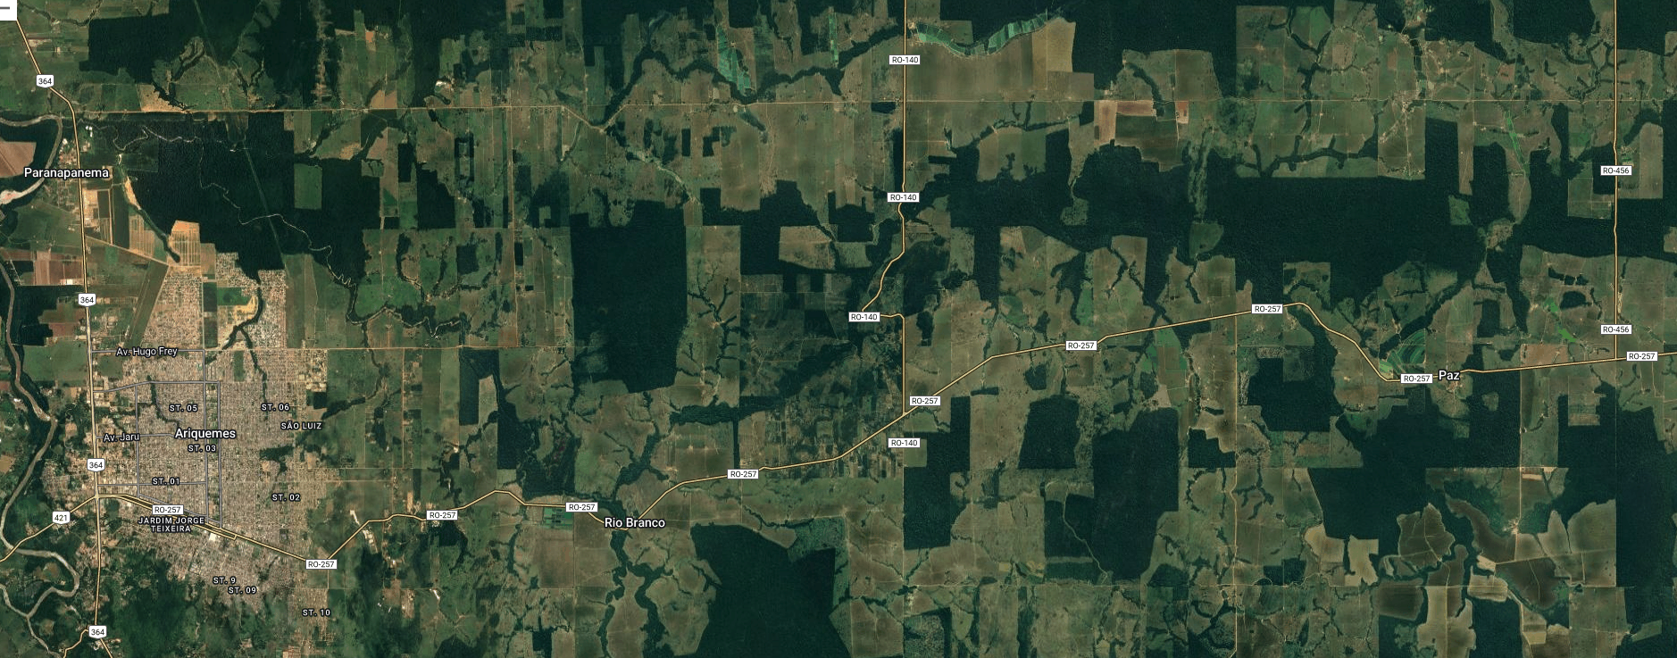
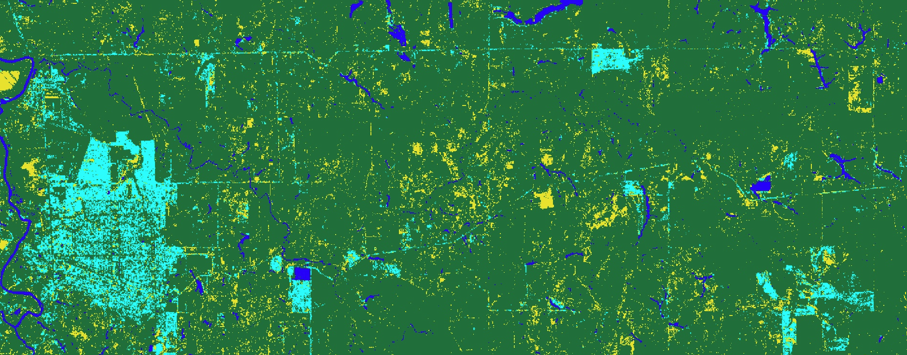
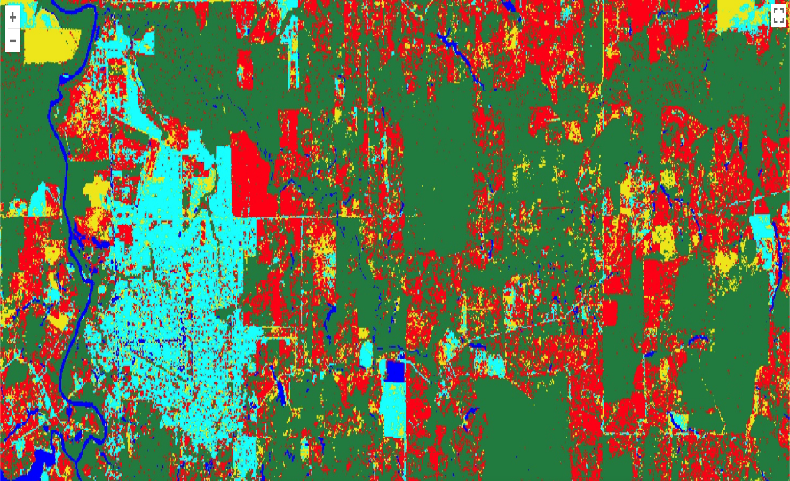
2020 Amazon Rainforest
Model – Random Forest Classifier
Accuracy – 0.8995
The first image on the left shows the original LANDSAT-8 satellite image of the Ariquemes region.
The second image displays the area classified into four categories: Built-Up Area, Densely Forested Area, Sparsely Forested Area, Deforested Area and Riverbank Area.

Slide 8
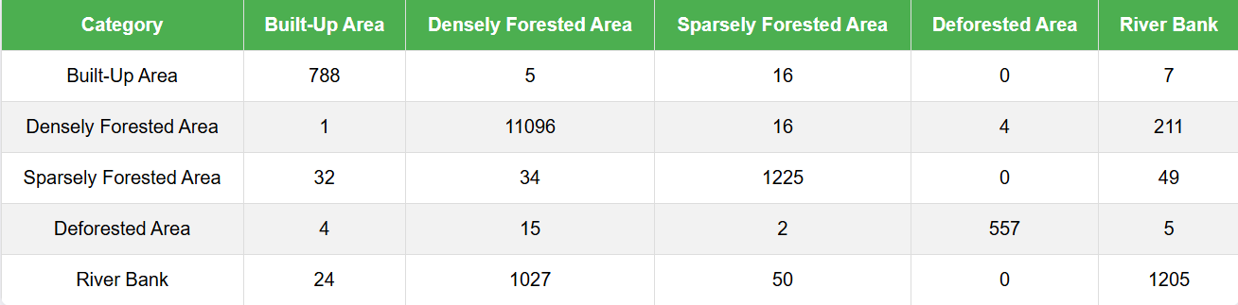
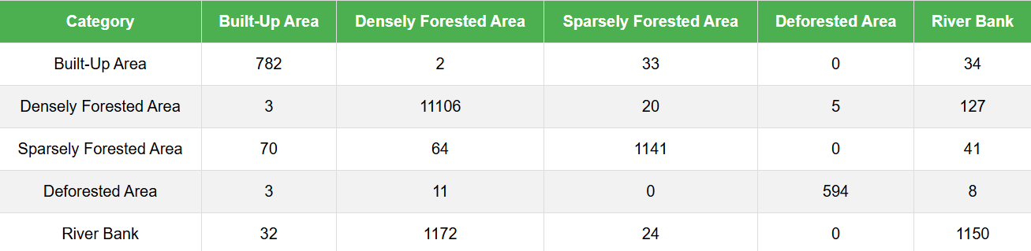
Confusion Matrix
Actual Class
Actual Class
Predicted Class
Predicted Class
2015
2020
Overall Accuracy:
Slight decrease from ~ 0.9082 % to 0.8995 %.

Slide 9
Results – Classification
Built-Up Areas (Cyan): Significant expansion from 2015 to 2020 indicating urbanization and infrastructure growth.
Densely Forested Area (Green): Its decrease is replaced by built-up (cyan) and deforested (yellow) areas, with a noticeable decline in the southern region by 2020.
Sparsely Forested Area (Red): It decreases over the two years.
Deforested Areas (Yellow): Increase near urban expansion zones, likely due to agriculture or development.
Riverbanks (Dark Blue): Increase in riverbank area, indicating increase in population near these areas.

Slide 10

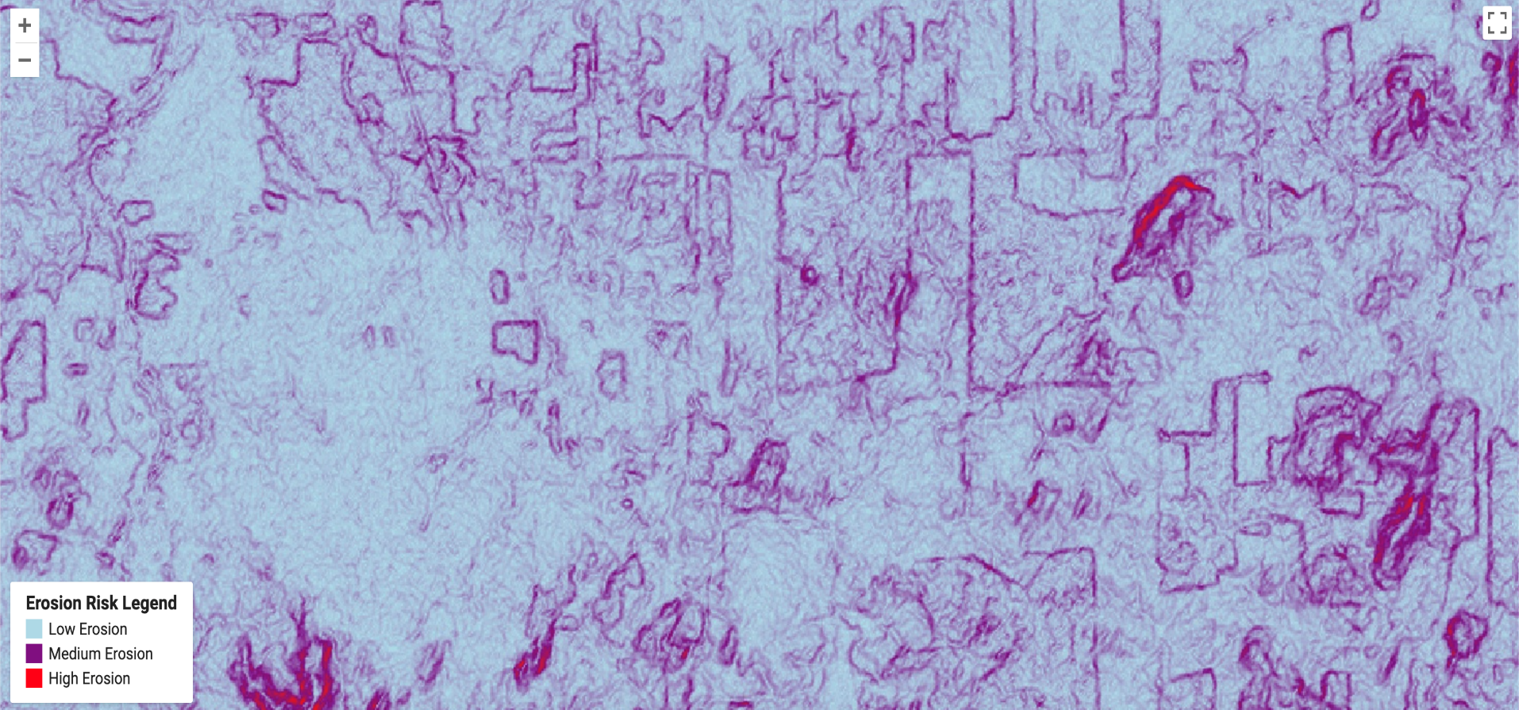
Soil Erosion Analysis - 2015

Slide 11

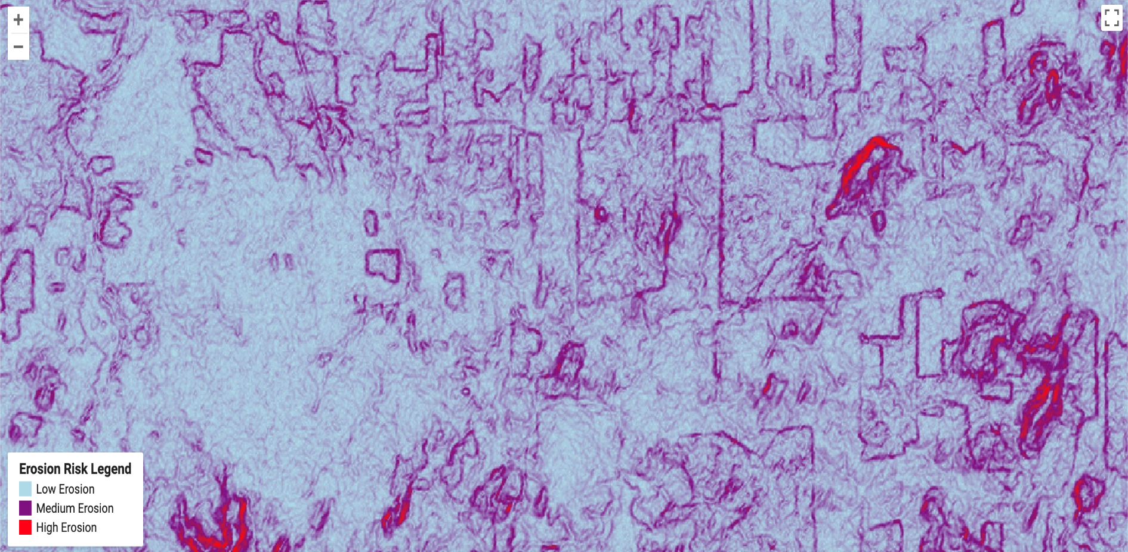
Soil Erosion Analysis - 2020

Slide 12
Results – Soil Erosion
In 2020, darker patches are observed in the northeast compared to 2015.
The central region also shows darker patches in 2020, indicating increased erosion.
Deforestation in the south eastern region has led to a corresponding rise in soil erosion.
Overall, soil erosion is higher in 2020 (dark regions are more prominent) compared to 2015.

Slide 13
Future Work
Incorporate wind speed and soil type into the soil erosion analysis.
Enhance model accuracy by considering these additional factors.
Improve the model’s applicability across various environmental conditions.

Slide 14
Conclusion
The analysis highlights critical trends in soil erosion and land cover changes in the Amazon Forest, emphasizing the need for sustainable land management, urban planning, and conservation initiatives to mitigate environmental impacts.

Slide 15
Thank you!

